Slide 1
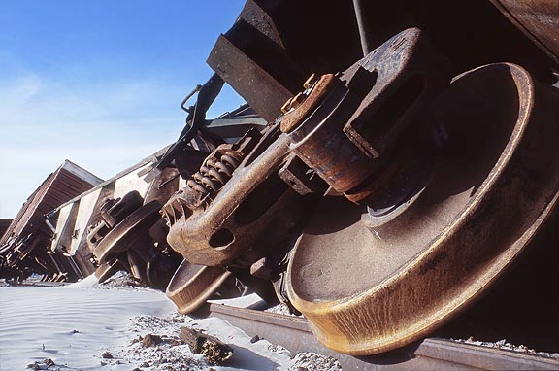
Project Management - AKA How to Avoid a Slow but Undreamably Costly and Destructive Train Wreck
kademorton@protonmail.com @rlcyberpathogen

Slide 2


Slide 3

Who am I and why are you listening to me?

Slide 4
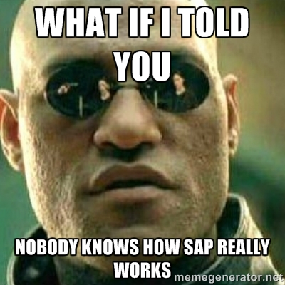
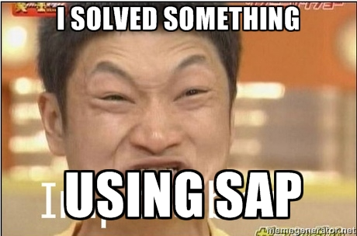



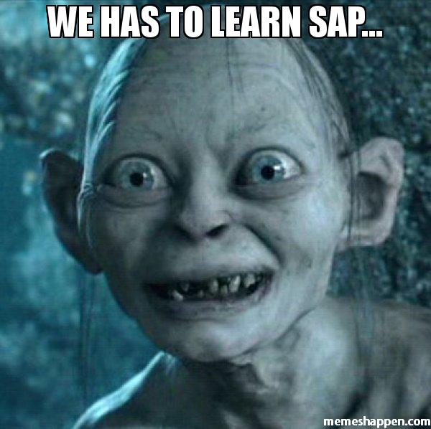
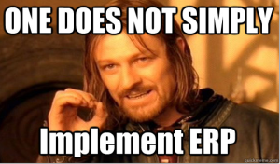
Why are you really listening to me?

Slide 5

Our customers

Slide 6

Explosions are exciting!

Slide 7

Pencils less so

Slide 8
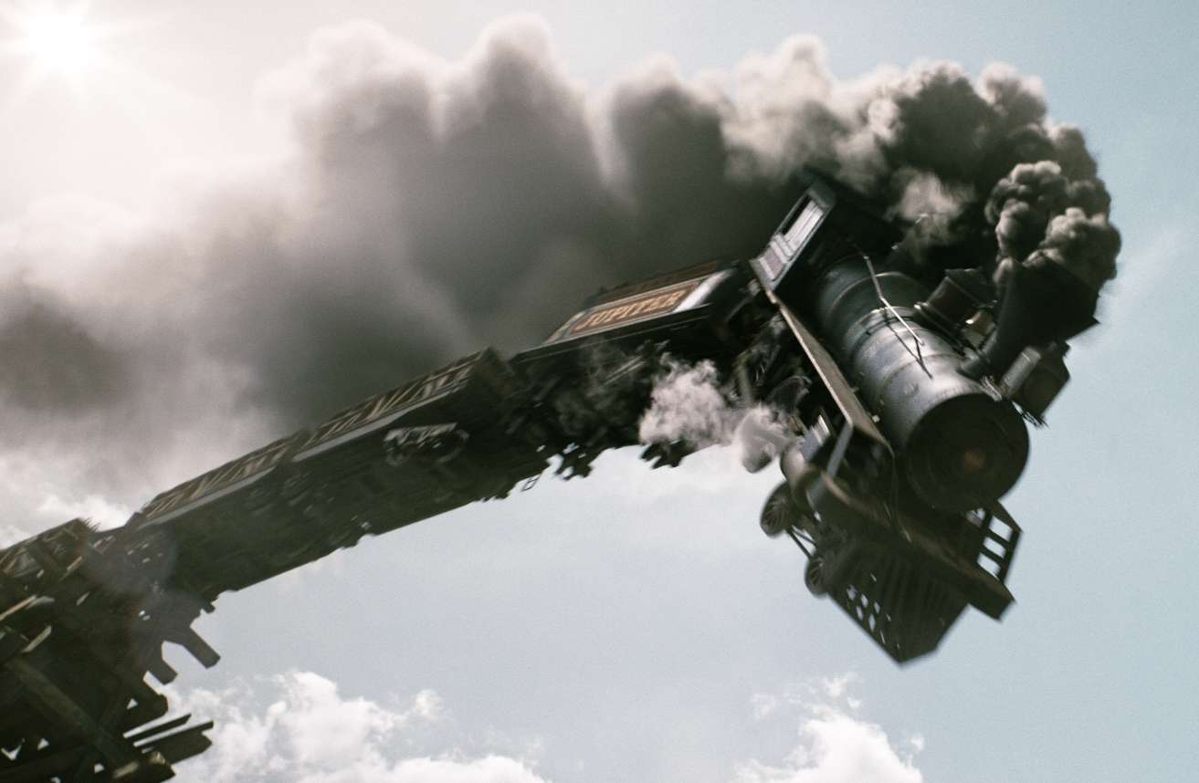
The logic says go somewhere that doesn’t exist… OK!!!

Slide 9

Exciting, exciting dynamite...

Slide 10

PM stands for Puppet Master

Slide 11
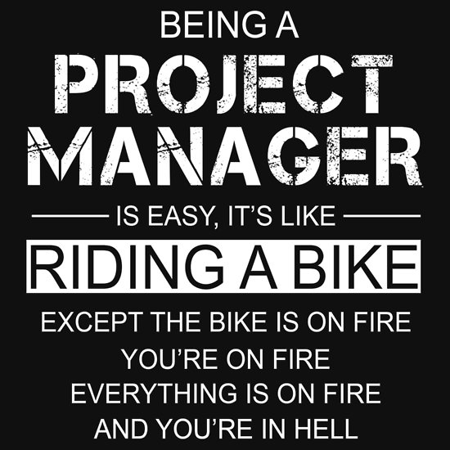
Project Management is fire
Project Management is fire

Slide 12

You will be looking at a bug...

Slide 13

...when the bug whispers...

Slide 14


Slide 15
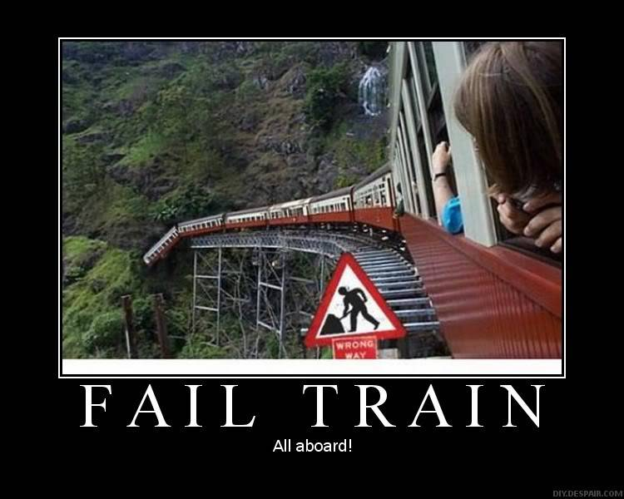
Entire deployment would have been derailed

Slide 16

Project Management is all about checklists

Slide 17
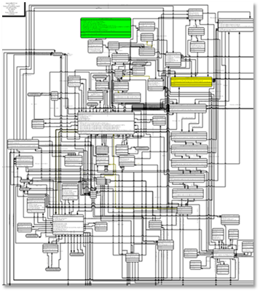
Yes, you need to understand this

Slide 18
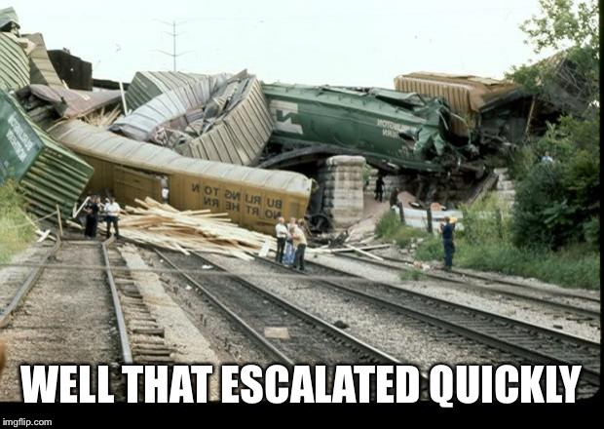
Missed a dependency? Miss a deadline...

Slide 19
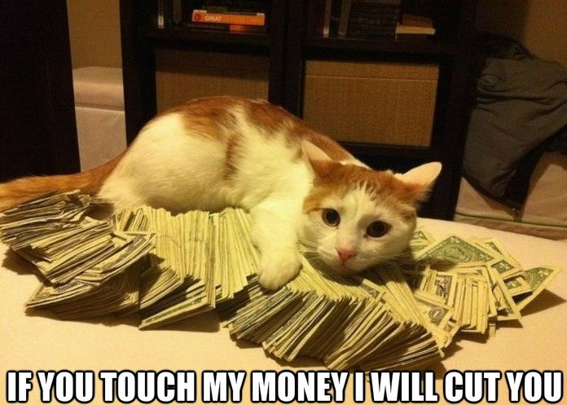
Miss a deadline? Miss a million bucks

Slide 20
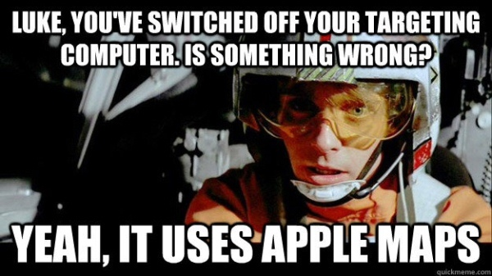
Having a map is all well and good...

Slide 21

Dictate processes when you find gaps

Slide 22
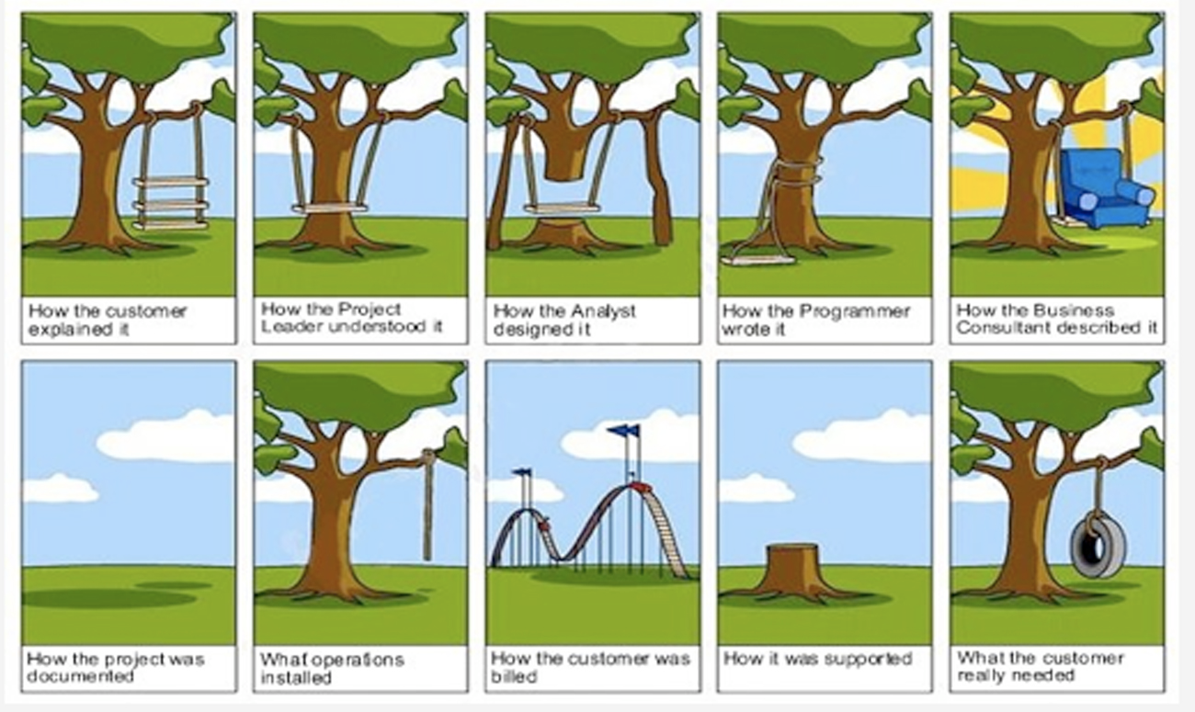
Validate what is being built and what’s needed

Slide 23

This is you with no money

Slide 24

This is still you with no money

Slide 25
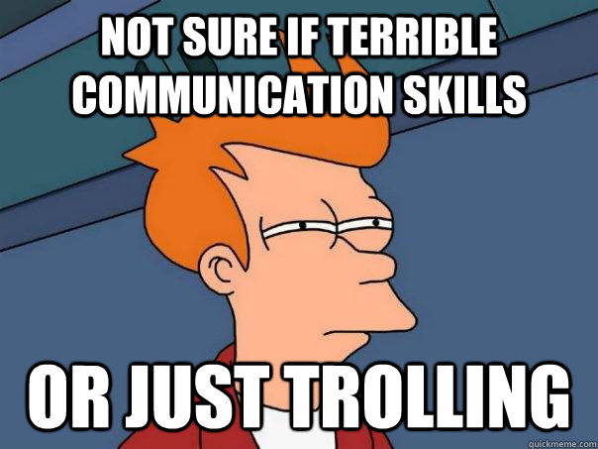
Communication is key

Slide 26

Test EVERYTHING

Slide 27
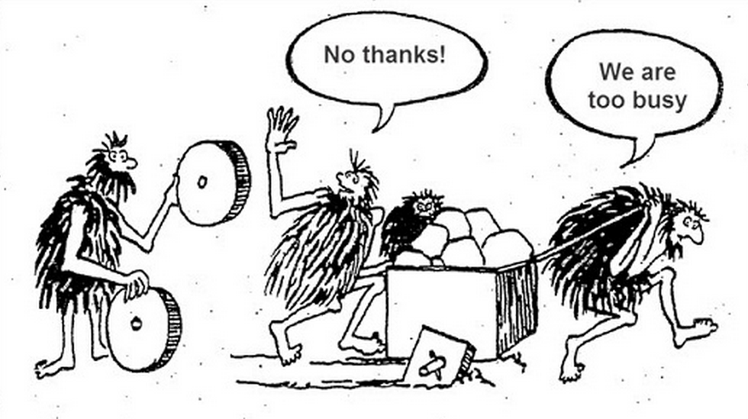
Don’t reinvent the wheel, codify things

Slide 28

Be Flexible

Slide 29

Enjoy your work

Slide 30
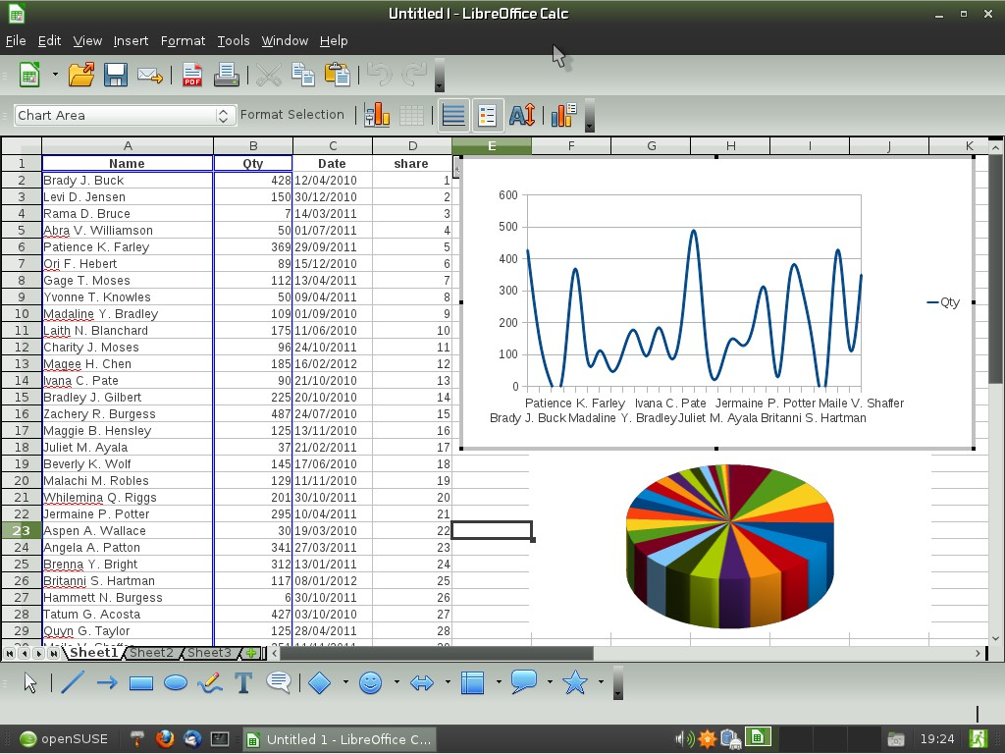
You think that’s excel you’re looking at?

Slide 31

This is how I see myself

Slide 32

This is how my friends see me

Slide 33
In conclusion
PM stands for puppet master
Project management is fire
At its core, project management is a checklist
Confirm business process to build checklist
Look for dependencies
Communicate properly
Test EVERYTHING
Document decisions
Be flexible
Have fun when you can
kademorton@protonmail.com @rlcyberpathogen

